Slide 1
Protein and Peptide delivery Basics of amino acid, Structures of proteins, Protein and peptide delivery: Barriers for protein delivery
Presented by:
Yashvi Gambhava
M.Pharm sem-1
Guided by:
Dr. Dhaval D. Mori
Assistant Professor

Slide 2
Basics of amino acid
As many as 300 amino acids occur in nature , only 20 known as standard amino acids are repeatedly found in the structure of proteins, isolated from different forms of life-animal, plant and microbial.
Amino acids are a group of organic compounds containing two functional groups– amino and carboxyl. The amino and group (-NH₂) is basic while carboxyl group (-COOH) is acidic in nature.

Slide 3
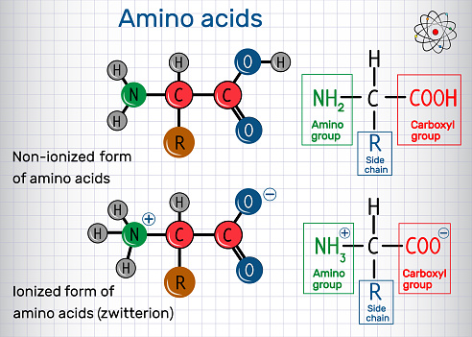
GENERAL STRUCTURE OF AMINO ACIDS
The amino acids are termed as α-amino acids, if both the carboxyl and amino groups are attached to the same carbon atom, as depicted below

Slide 4
The α-carbon atom binds to a side chain represented by R which is different for each of the 20 amino acids found in proteins.
The amino acids mostly exist in the ionized form ( Zwitter ion ) in the biological system (shown above).

Slide 5
Peptides : peptides are short chain of amino acids that have been linked by amide ( peptide), bonds.
The term peptide generally refers to a compound made up of two or more amino acids, peptides can further classified as either oligopeptide or polypeptides.
peptide<50 amino acids
Proteins : proteins are generally distinguished from polypeptides according to their size and structure. In terms of size, a polypeptide composed of more amino acids.
Protein > 50 amino acids

Slide 6
Structures of proteins
1. Primary structure : The linear sequence of amino acids forming the backbone of proteins ( polypeptides ).
2. Secondary structure : The spatial arrangement of protein by twisting of the polypeptide chain.
3. Tertiary structure : The three dimensional structure of a functional protein.
4. Quaternary structure : Some of the proteins are composed of two or more polypeptide chains referred as subunits. The spatial arrangement of these subunits is known as quaternary structure.

Slide 7
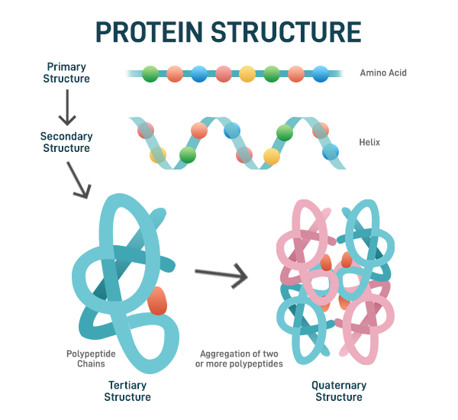
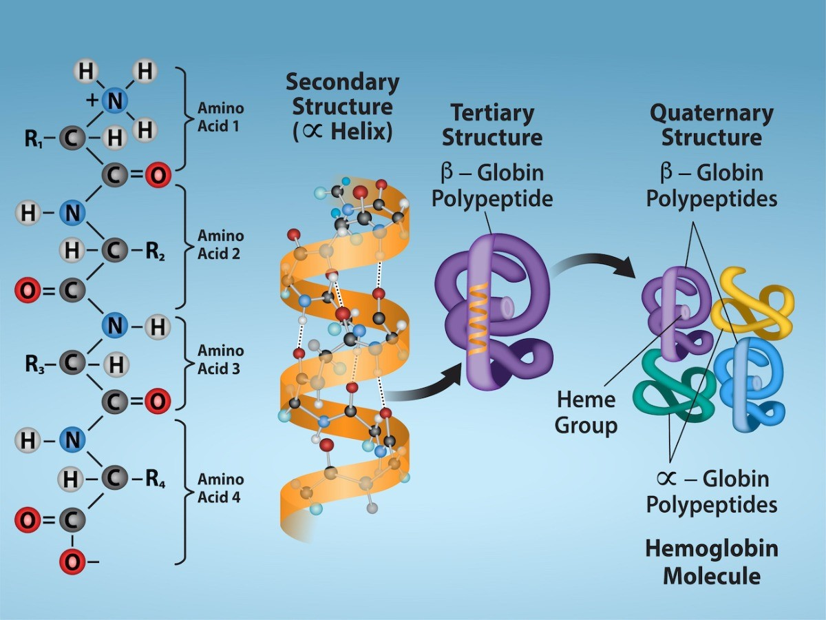

Slide 8
Introduction
Proteins and peptides are essential molecules for life and they have vital roles in almost all biochemical processes in the human body.
Proteins and peptides have a wide range of functions including regulation of gene expression, signal transduction, catalysis of reactions, transportation, and immunity-related functions. Proteins and peptides are also involved in various pathological conditions such as diabetes, hypertension, and cancer.
Because of their wide range of functions as well as involvement in various diseases, proteins and peptides can be attractive therapeutic agents for combating these diseases
Peptide drugs structurally mimic the endogenous peptides responsible for modulating target proteins that play a critical role in human physiology.
Examples include hormones, neurotransmitters, growth factors, antibacterial agents, and many others.

Slide 9
Currently, protein drugs are being pursued for the treatment of diverse diseases including metabolic disorders, autoimmune diseases, and cancers.
Although many therapeutic proteins are now in the pharmaceutical market, the most common route of administration for therapeutic proteins is parenteral injection.

Slide 10
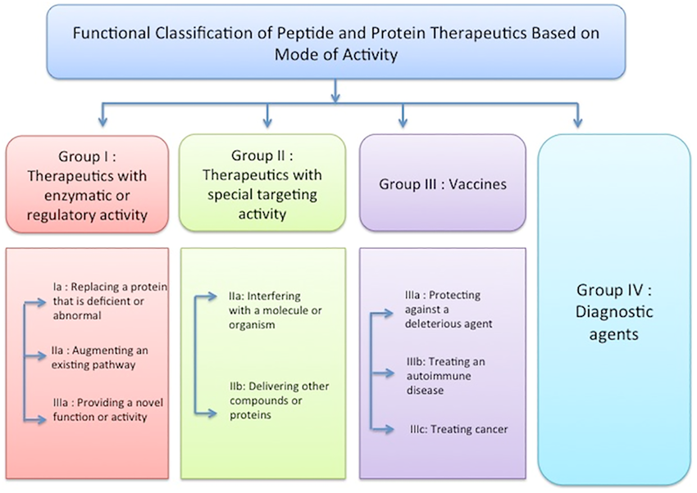

Slide 11
Delivery of Peptide and Protein drugs
Different routes include
1. Oral route
2. Buccal route
3. Nasal route
4. Transdermal route
5. Pulmonary route
6. Rectal route
7. Parenteral route

Slide 12
Barriers to Non-Invasive Formulation Development for Proteins

Slide 13
Physicochemical Drug Properties
Intrinsic properties of protein-based drugs such as their large size, poor membrane permeation, physicochemical instability, and susceptibility to enzymatic degradation create a formidable challenge with respect to the delivery of protein drugs, particularly for non-invasive drug delivery
the high molecular mass and the large size of drug molecules often result in poor membrane permeability, which causes low absorption.
Drugs with a relatively small molecular mass of <500 Da readily penetrate membranes in the GI tract and skin through passive diffusion.
ocular delivery, the human retina restricts the diffusion of macromolecules >76 kDa due to inner and outer plexiform layers and macromolecules above 150 kDa are unable to reach the inner retina
The nasal mucosa also exhibit low membrane permeability for molecules larger than 1 kDa

Slide 14
The hydrophilicity of therapeutic proteins also has a great impact on their cellular transport. Most protein drugs are highly hydrophilic with a log P value of less than zero
Another physicochemical drug property influencing absorption is the surface charge of a therapeutic protein, which is derived by the amino acid sequence of the protein and the pH of its surroundings. This physicochemical property is complex and heterogeneous.
The surface charge can cause protein drugs to interact with molecules on the cell surfaces or tissue components, thereby affecting absorption, distribution, and elimination of proteins in the body.

Slide 15
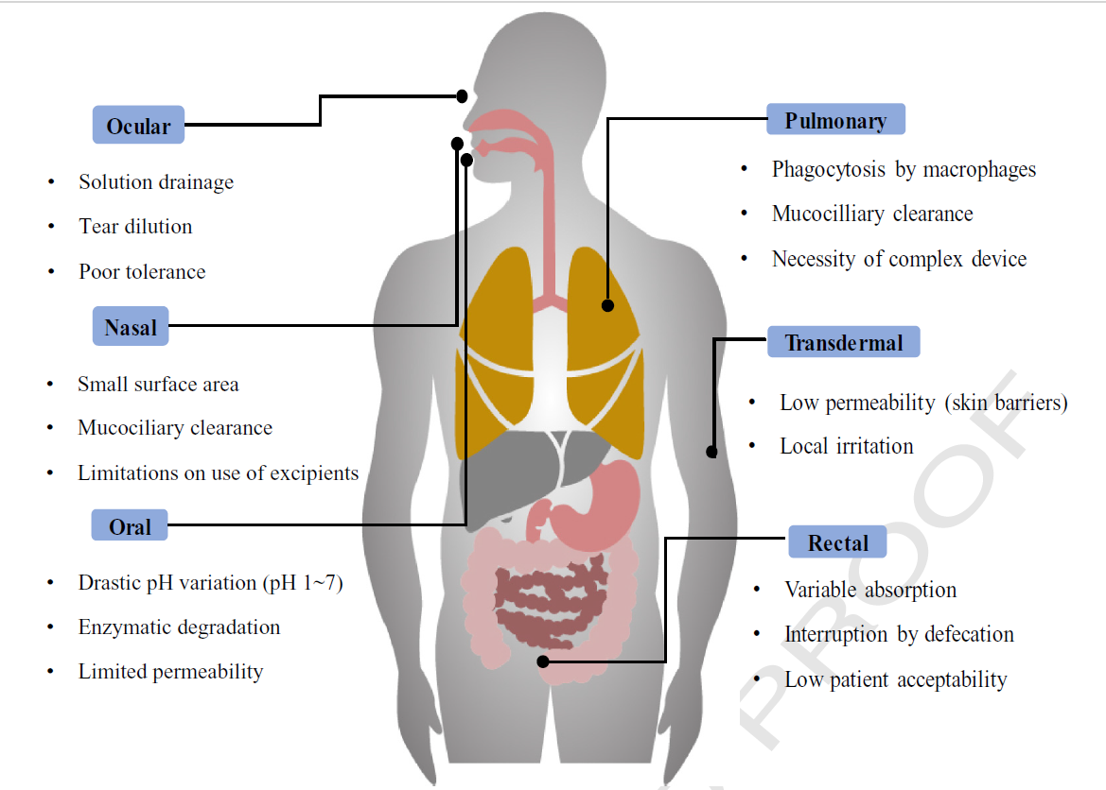
Main barriers for noninvasive routes administration.

Slide 16
Biological Barriers
pHs of Biological Environments
The pH conditions in various biological environments can affect the ionization, chemical instability, and absorption of protein-based drugs and their delivery systems. protein drugs are often unstable at physiological pHs
the strongly acidic gastric environment (pH 1 – 3) causes destabilization of protein drugs in the stomach, but chemical degradation reduces significantly in the ileum and colon due to higher pHs
In an ocular delivery system, the buffering agent plays an important role since hyperosmotic solutions cause transient dehydration of the anterior chamber tissues while hypotonic solutions may cause edema

Slide 17
Enzymatic Barrier
Enzymatic degradation in the gastrointestinal (GI) tract is a formidable barrier against the oral delivery of proteins and leads to low bioavailability.
While the enzymatic activity of proteases is high in the small intestine, the proteolytic activity in the colon is comparatively lower
Mucosal Barriers
Mucus and epithelial cell layers act as the major absorption barrier against non-injectable drug administration
All mucosal epithelia are covered in a layer of mucus, which serves as the first line of defense at the surfaces of the eye, respiratory tract, and gastrointestinal tract against mechanical damage or the entrance of harmful substances

Slide 18
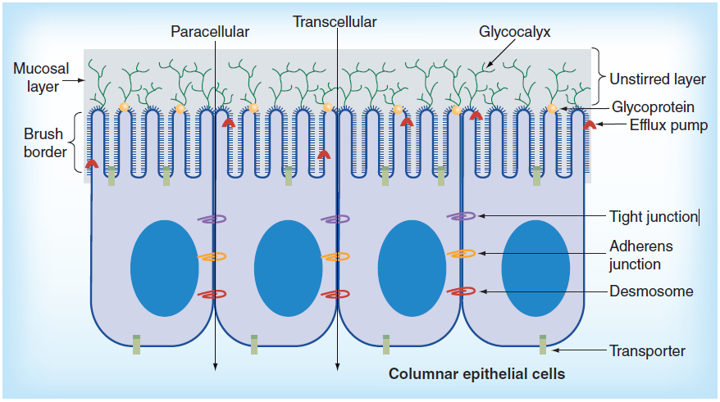
Intestinal barriers to peptide delivery. The epithelial intestinal barrier is made up of a single layer of columnar epithelial cells. The apical side of the barrier contains the mucosal layer. Drugs may penetrate the epithelial barrier either through the transcellular route (across the cell) or the paracellular route (between tight junctions).

Slide 19
Others
The ocular delivery of proteins is hindered by the blood-retinal barrier and efflux transporters (MRP1, 4 and 5) expressed in the posterior segment.
In addition, the viscosity of formulations can affect ocular drug delivery.
High viscosity increases the corneal contact time but leads to reflex tearing and blinking of the eye, which alters the viscosity of the formulations.

Slide 20
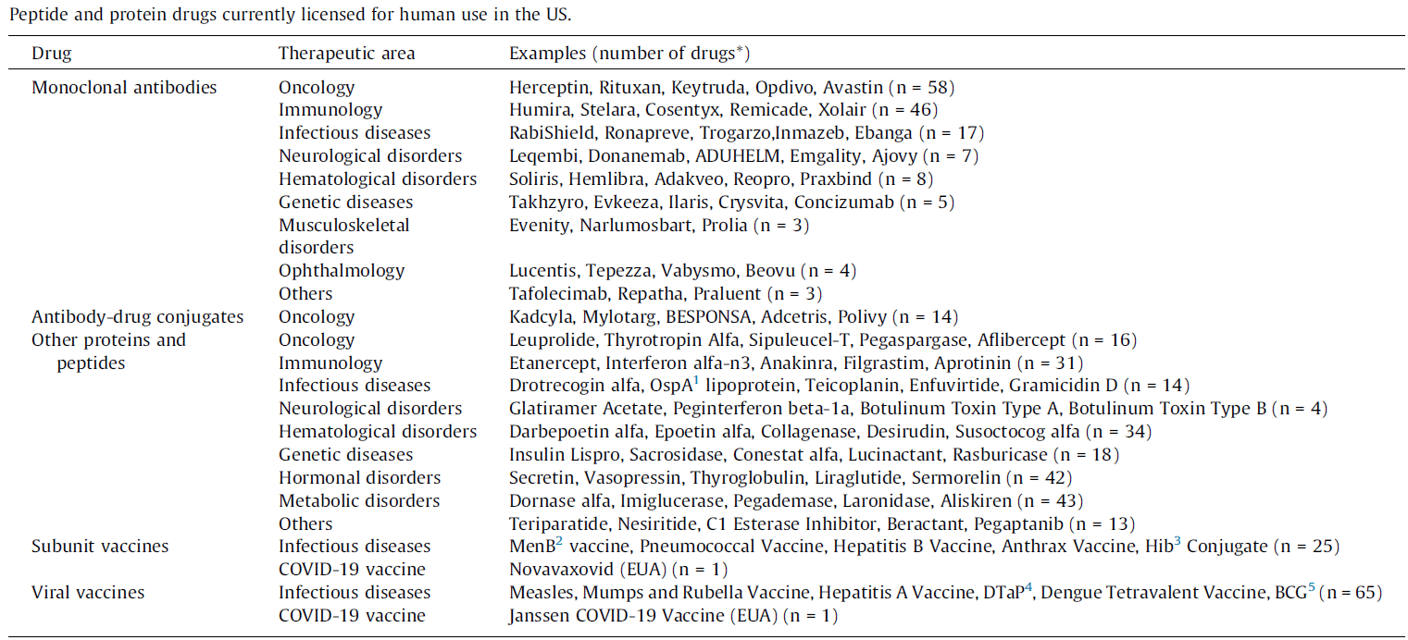

Slide 21
Parenteral Route
Parenteral mode of drug delivery has been the major route of choice for protein/peptide, owing to their poor absorption and metabolic instability when given by other alternative routes.
The parenteral drug delivery system includes Intravenous, intramuscular, subcutaneous, intraperitoneal, intrathecal use.
The IV administration offers complete delivery of the administrated proteins and peptides to the systemic circulation and avoids going into any presystemic clearance process.
IM and SC administrations can have variability in the bioavailability of the administrated proteins and peptides. This is because therapeutic agents administrated by these routes can be subject to metabolic inactivation prior to reaching the systemic circulation.
There are other factors that can cause variability in the bioavailability rate of IM and SC administrated therapeutic agents such as the blood flow in the administration site.

Slide 22
Chemical Modifications of Proteins and Peptides
PEGylation
PEGylation, the attachment of a flexible strand or strands of polyethylene glycol (PEG) to a protein.
PEG is a simple, water-soluble, non-toxic polymer that is non-immunogenic, is readily cleared from the body, and has been approved for human administration by mouth, injection, and topical application.
The most common process used for PEGlyation of protein is to activate the PEG with functional groups suitable for reaction with lysine and N-terminal amino groups.
PEGylation has also been used as a systemic stability enhancer.
Direct PEGylation can aid in the stability of proteins for delivery, mainly leading to an increase in circulation time.

Slide 23
Newer PEGylation methods such as living radical polymerization, free radical polymerization, atom transfer radical polymerization and reversible addition fragment transfer have allowed PEGylation with greater specificity and purity while making modification with PEG a simpler task.
Chemical Modification – PEGylated Interferon alfa-2a
Interferon alfa-2a (Roferon A®) of Hoffman-La-Roche was approved by US FDA for use in chronic Hepatitis C and hairy cell leukemia in the year 1984 as subcutaneous injection to be administered 3 times a week for 48-52 weeks at a dose of 3 MIU. In the year 2002, a second generation of Intereferon was launched with branched PEG molecule with an average molecular weight of around 43 kilodaltons attached to it as Pegasys® (PEGylated interferon alfa-2a).

Slide 24
Pegasys® shows better characteristics in the treatment of chronic hepatitis C than does the unmodified interferon (IFN) used to date. In animal models PEGylation produced a 12 to 135- fold increase in effect against viruses and an 18-fold increase in effect against tumor cells. Dosage of modified form of Interferon is 180 mcg once weekly for 48-52 weeks. The mean terminal half life of Pegasys® was 80 hrs as compared to 5 hrs in Roferon A®.

Slide 25
Local administration and long-acting injectables
Many extended release technologies have been developed for SC and IM injections, they can be applied to other injection strategies through proper formulation design.
Four main types of extended release technologies are used in commercial products are microparticles, liquid crystals, in situ depots, and implants.
These technologies enable durations of release on the order of weeks to years depending on their design.
The first technology, polymeric microparticle formation, is well established and used to sustain the release of therapeutic agents. The therapeutics of interest is encapsulated within a biodegradable polymeric particle (e.g., PLGA and PLG).

Slide 26
Encapsulation within polymeric microparticles has been applied to a variety of therapeutics with a range of physicochemical properties from small molecules to proteins.
Release is controlled by the rate of polymer degradation and can typically be sustained from one week to six months.
The second technique is liquid crystal formulation, which is comprised of oily solutions or suspensions of highly lipophilic compounds wherein the lyotropic liquid crystalline phase is formed in excess water.
Prodrugs or insoluble salts can also be used to modulate the properties of the compound to enable extended release.
Release is controlled by either diffusion from the oil or dissolution of the insoluble particles and has been used for sustained release from two weeks to three months.

Slide 27
Thirdly, in situ depots rely on the precipitation of a polymer matrix or gel upon administration.
Release is controlled by degradation of the polymer matrix and provides sustained therapeutic release from one week to six months.
Since the polymer and active drug substance are dissolved in an organic solvent, dose volume must be limited due to tolerability of the solvent.
Additional considerations such as solution viscosity and stability of the polymer and active drug substance in the chosen solvent must be considered.

Slide 28
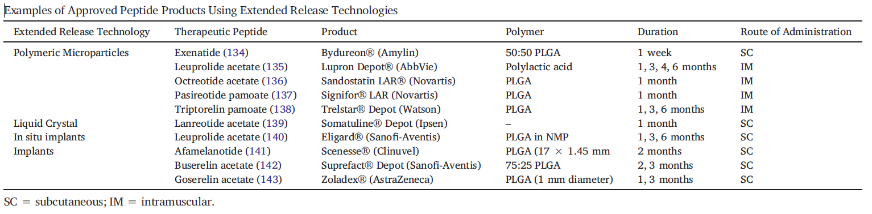
Lastly, implants offer the longest duration of release typically from one to five years, again mainly driven by polymer degradation.
Fine control over the release rate is possible; however, there is also high complexity associated with the formulation and manufacturing related to this technology.
Additionally, surgical insertion is required for some products; however, this offers the opportunity for implant removal should that be required.

Slide 29
Control release system for protein peptide delivery
Hydrogels
Hydrogels can be used directly as protein delivery systems or as tissue engineering scaffolds supporting cell growth with or without protein release.
Protein release from hydrogels can be controlled through a number of mechanisms, including drug diffusion, electrostatic interactions, hydrophobic interactions, hydrogel degradation, cleavage of degradable protein linkers, guest–host interactions, and dynamic covalent bond formation.
Both synthetic and natural materials have been used as hydrogel protein delivery systems. Among the synthetic materials, poly (ethylene glycol) (PEG) is particularly common, but poly(vinyl alcohol) (PVA) and poloxamers are also widely reported.
Scaffolds composed of natural polymers, including collagen, silk fibroin, hyaluronic acid (HA), fibrin, self-assembling peptides, starch, fibrin, chitosan, and alginate, have also been well described.

Slide 30
The most common approach to loading hydrogels with drugs is to simply submerge or swell the hydrogel in an aqueous protein loaded solution, enabling the drug to infiltrate the hydrogel network.
if the protein’s hydrodynamic diameter is smaller than the pore size, it will release rather quickly once it is placed in the body or a release solution unless specific elements increase the affinity of the protein for the hydrogel.
When the hydrogel pores are smaller than the protein diameter, swelling or degradation is needed to increase the mesh size. Degradation can occur in the polymer backbone or at the crosslinks and is typically mediated by hydrolysis or enzymatic activity.

Slide 31
Novel Injectable Polymeric Depot Systems
Among the various approaches to deliver macromolecules paretnerally, polymeric injectable depot systems are the most commercially successful. Parenteral depot systems include microspheres, nanospheres, liposomes and polymeric solutions/gels.
Many of the marketed parenteral controlled-release products of proteins are polymeric microsphere formulations which can be injected either intramuscularly or subcutaneously for systemic effect or injected into a specific body site for localized treatment.
Microspheres are free flowing powder having particle size between 10 to 100μm in diameter, can be suspended in a suitable vehicle for injection.
There are several methods of microencapsulating proteins or peptides molecules into microspheres like emulsification followed by solvent evaporation/cross-linking, emulsion polymerization, spray drying, supercritical fluid technology and electro spray.

Slide 32
Several other proprietary encapsulation technologies such as ProLease® PolyShell®, supercritical fluid technologies have been explored to fabricate biodegradable microspheres.
Polymeric depot forming or gel forming solution technologies are developed, which have several advantages over microspheres.
Atrigel®, a depot forming solution technology, consists of biodegradable polymers dissolved in biocompatible organic solvent such as N-methyl-2-pyrrolidone, which convert into depot after intra-muscular injection.
Atrigel® technology has been used in EligardTM, a leuprolide containing product.
Most of the polymers used in the delivery of protein by injectable depot techniques are biodegradable and biocompatible.
Polylactides (PLA)
Polyglycolides (PGA)

Slide 33
Polymeric Depot System – EligardTM (Leuprolide Acetate)
Eligard™ 7.5 mg is a sterile polymeric matrix formulation of leuprolide acetate for subcutaneous injection.
It is designed to deliver 7.5 mg of leuprolide acetate at a controlled rate over a one month therapeutic period. Leuprolide acetate is a synthetic nonapeptide analog of naturally occurring gonadotropin releasing hormone (GnRH or LHRH) that, when given continuously, inhibits pituitary gonadotropin secretion and suppresses testicular and ovarian steroidogenesis.
Clinical studies showed that EligardTM delivered sustained levels of leuprolide acetate over a one-month period with the desired results of lowering testosterone levels in the 117 men studied.

Slide 34
Surgical Implants
Surgical implants are ideal delivery systems for the controlled release of drugs for more than six months. Alza’s DUROS® implant technology which is used in leuprolide acetate containing Viadur®, the first successful product is a once-yearly implant for the palliative treatment of advanced prostate cancer.
Lipid Based Protein Delivery Systems
Lipid based drug delivery systems like liposomes are also reported in the for the delivery of proteins and peptides.
Liposome formulations with prolonged circulation time have been developed as a potential sustained-release drug delivery system and such formulations can also be used to prolong the circulation time of proteins and peptides by conjugating them to the surface of liposomes.

Slide 35
Increase of the circulation half life ranged from 2- to 150-fold depending on the protein/lipid ratio of the liposomal formulation, liposome size, and the lipid composition of liposomes.
Conventional liposomal technologies were found to be unsuitable for encapsulation of large amount of water soluble macromolecules.
To overcome some of these problems, multivesicular lipid-based delivery system such as DepoFoamTM (Skye Pharma) which are microscopic, spherical particles composed of multiple nonconcentric aqueous chambers surrounded by a network of lipid membranes have been developed.
The individual chambers are separated by bilayer lipid membranes made up of synthetic analogues of naturally occurring lipids, resulting in a delivery vehicle that is both biocompatible and biodegradable.

Slide 36
The rate of drug release from a DepoFoam™ formulation is controlled by modification of the lipid components, aqueous excipients and manufacturing parameters used in production of the formulation.
DepoFoam™ formulations of protein such as insulin, and peptides such as leuprolide, enkephalin and octreotide have been developed and characterized.
The data show that these formulations have high drug loading, high encapsulation efficiency, low content of free drug in the suspension, little chemical change in the drug caused by the formulation process, narrow particle size distribution, and spherical particle morphology.

Slide 37
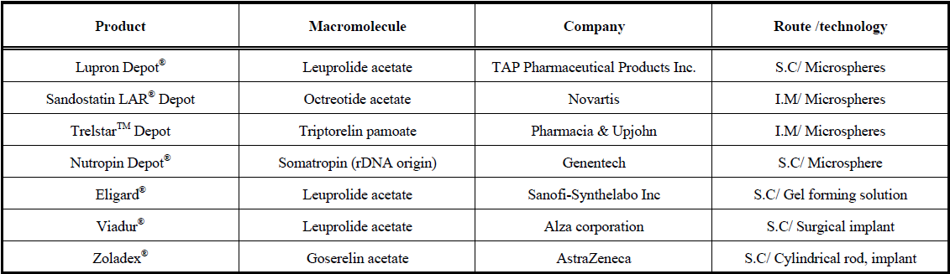
Examples of Marketed Parenteral Depot Products

Slide 38
Systemic peptide stability & site-specific delivery
Nanoparticles
NPs play a role in the protection and delivery of peptides in systemic circulation.
One example, the carbon nanotube, is well-studied and has been used to deliver proteins.
Functionalized NPs have been used to deliver antibodies, active proteins and epitope peptides to the immune system.
A recent study revealed new details on the mechanism of protein release from protein-loaded nanoparticle systems. The release of protein from an aliphatic polyester-based nanoparticle system was caused by bulk degradation of the nanoparticle. Moreover, intramolecular transesterification was followed by hydrolysis of the polymers, which caused the degradation.

Slide 39
Lyophilizing NPs led to a higher burst release of protein (40–50%) compared with nonlyophilized NPs (10–20%).
Many types of NPs other than carbon nanotubes have been used in systemic drug delivery. A type of nanoparticle made of a PCL–PEO combination was able to demonstrate increased accumulation at the tumor site as well as reduced clearance by macrophages of the liver, thus increasing the possibility of the nanoparticle taking advantage of the EPR effect

Slide 40
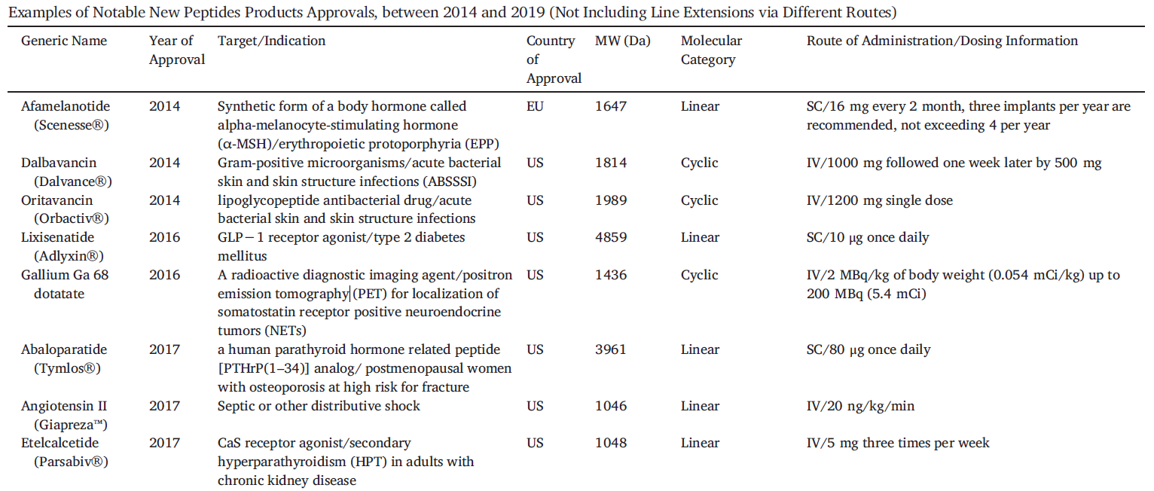

Slide 41
Formulation Strategies for Non-Invasive Protein Drug Delivery

Slide 42
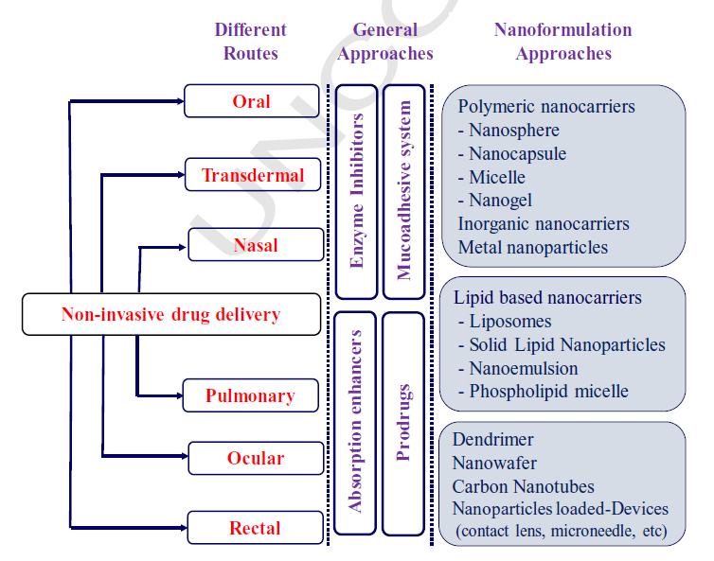
Approaches for protein drug delivery via non-invasive routes of administration.

Slide 43
Oral Delivery
Oral ingestion is typically the most preferred route of administration due to good patient compliance. Furthermore, oral dosage forms are cost-effective compared to parental dosage forms
However, the development of oral formulations for protein drugs presents a difficult challenge due to many barriers including the large molecular mass, size, physicochemical instability, enzymatic degradation, and low membrane permeability,
advancements in nanotechnology have fueled progress in oral protein delivery systems

Slide 44
Chiasma
Chiasma recently gained FDA approval for their oral octreotide formulation, becoming the first approved oral somatostatin analog. In this product, octreotide is formulated with sodium caprylate (permeation enhancer) as a hydrophilic powder (with PVP) and then dispersed in a lipophilic medium comprising polysorbate 80, glyceryl monocaprylate, and glyceryl tricaprylate to form an oily suspension.
In rodent models, the formulation increased reversible paracellular transport leading to increased bioavailability of octreotide

Slide 45
